Slide 1


Intelligent Diagnostic Classification
Applying Responsible AI to Optimize Malignant Tumor Recall and Clinical Safety

Slide 2

Executive Summary
Achieving 98.25% test accuracy through an end-to-end, medical-grade ML pipeline prioritizing life-critical recall.

Slide 3






Asymmetric error costs demand recall-focused optimization
Critical Stakes
Objective
Safety First
In clinical settings, missing a malignant case (False Negative) has far higher human cost than a False Positive.
Construct a binary classifier that acts responsibly by maximizing recall for high-risk malignant cases.
Model selection criteria shifts from simple accuracy to a composite of sensitivity and ROC-AUC metrics.

Slide 4
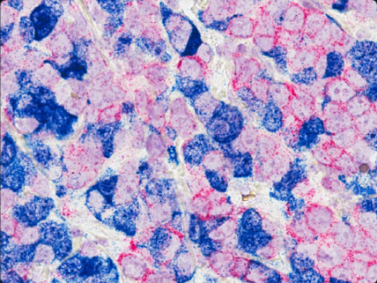
High-fidelity nuclear morphology benchmark
Origin
Wisconsin Breast Cancer (Diagnostic) dataset from digitized FNA imaging.
Complexity
30 numeric features capturing mean, SE, and "worst" nuclear dimensions.
Cohort
569 patient records with 0 missing values for robust statistical modeling.

Slide 5



A standardized pipeline for clinical reproducibility
Phase 1: Analysis
Phase 2: Modeling
Phase 3: Export
Exploratory Data Analysis identified mean concave points and radius as high-correlation drivers.
Stratified sampling and 5-fold cross-validation inside the pipeline prevent data leakage.
Serialization via Joblib captures both scaling logic and the optimized classifier for deployment.

Slide 6
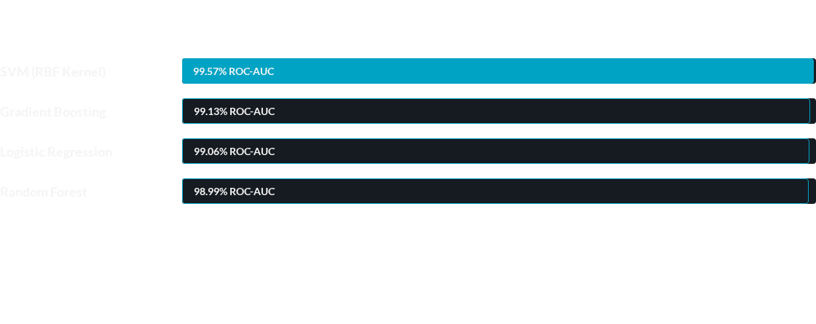
SVM RBF provides the optimal clinical frontier
Superior non-linear separability of SVM (RBF) minimizes error variance across all cross-validation folds.

Slide 7

Class balance supports stratified training
Balanced distribution allows for effective stratified splitting, ensuring the test set reflects the real-world minority incidence.

Slide 8
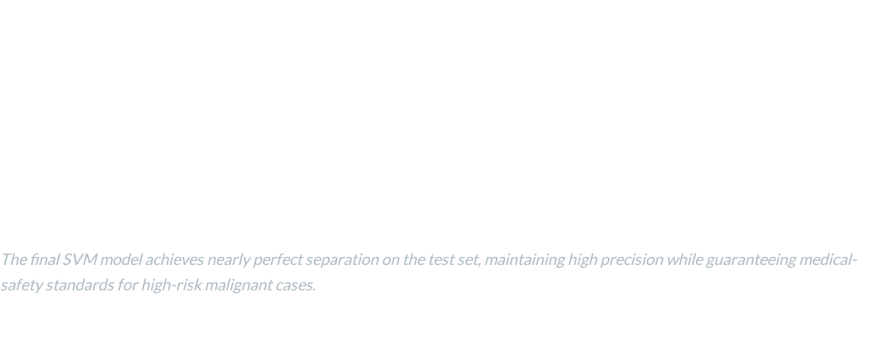
Superior accuracy and predictive confidence
98.3
0.99
95
% ACCURACY
ROC-AUC
% RECALL (M)

Slide 9
Safety-centric model tuning
Prioritizing clinical sensitivity to minimize false negatives in malignant case detection.
biotech
verified
health_and_safety
95%
97%
Clinical Impact
Malignant Recall
Optimized sensitivity ensures that true malignant cases are rarely missed.
Benign Precision
High accuracy in identifying benign cases reduces unnecessary biopsies and patient anxiety.
Pipeline Safety
Significantly reduced liability and improved reliability within automated clinical diagnostic pipelines.
By optimizing for recall over raw accuracy, the model ensures clinical safety standards are met.

Slide 10

Morphological drivers of malignancy
Permutation importance highlights that cell nuclear concavity and sheer size are the primary physiological markers used by the model.

Slide 11


Operationalizing the diagnostic engine
Ready for Clinical Integration
The standardized pipeline wrapper handles scaling and inference in a single step, ensuring the model behaves identically in production as it did during training.
Persistent scaling parameters
Serialized SVM engine
O(1) inference speed

Slide 12
Thank You

